Slide 1

INSIDE AIR BNB
NYC
Group:
Ravi Amin (306598765)
Shardul Dave(306598622)
Kruti Shah (306650284)
Rutvi Patel (306019563)
Under guidance of:
Dr. Mohammad Pourhomayoun

Slide 2
Introduction
Airbnb is an online service that allows people to rent their properties for short term lease or vacation rentals.
The rental property price is determined by the host and the company receives a percentage of the stay as a service fee.
Airbnb has a predictive tool for hosts to utilize in order to set a competitive price for their rental property. The tool is based on a description of the property, but the host ultimately determines the price. The goal this study is to create a predictive model based on Airbnb data to better understand how hosts actually price their property rentals.

Slide 3
About the Dataset
It includes home rented in the past years. We will use different algorithm to predict the price.
Row: 44317
Column: 96
Size: 161 MB
Dataset Link: https://www.kaggle.com/peterzhou/airbnb-open-data-in-nyc
(listing_details.csv): Detailed listing data, including various attributes (features) of each listing such as number of bedrooms, bathrooms, location etc.

Slide 4
Objective
The goal of our study is to build a predictive model that explains how renters value their properties and set their rental prices in New York City. In order to reach this goal the necessary objectives include:
Analyze and understand data for rental prices
Identify features and labels for Airbnb rental prices
Use different models and trained them to predict a house price RMSE
Finding the best features amongst the all.

Slide 5
Price Visualization
Get frequency by Price for listings
Get frequency of bedroom number for listings
Plot listings on scatterplot by using Latitude and Longitude

Slide 6
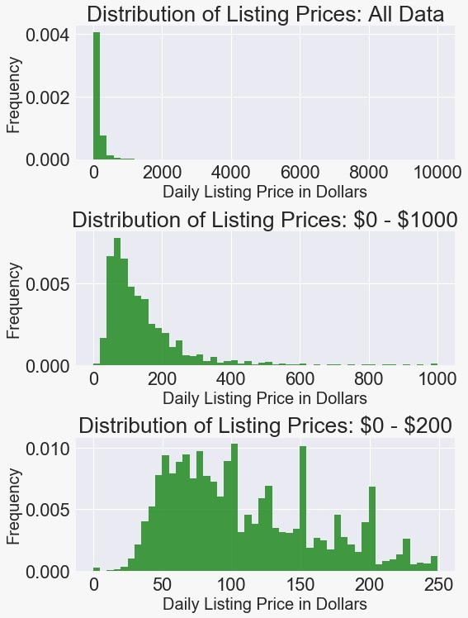
Get frequency by Price for listings

Slide 7
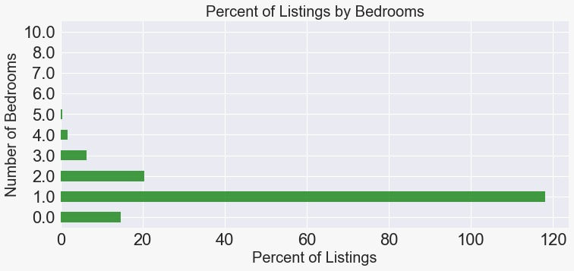
Get frequency of bedroom number for listings

Slide 8
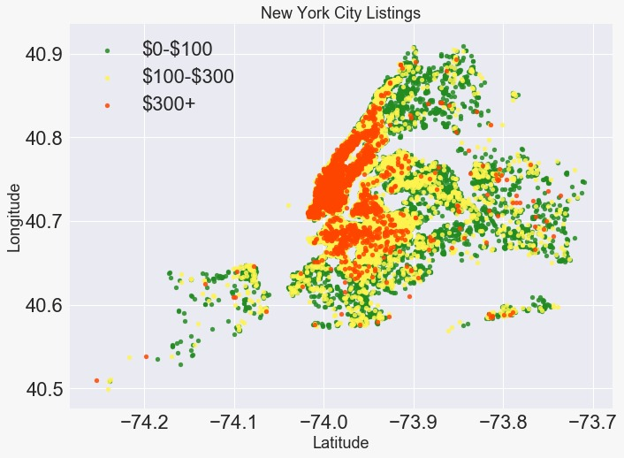
Plot listings on scatterplot by using Latitude and Longitude

Slide 9
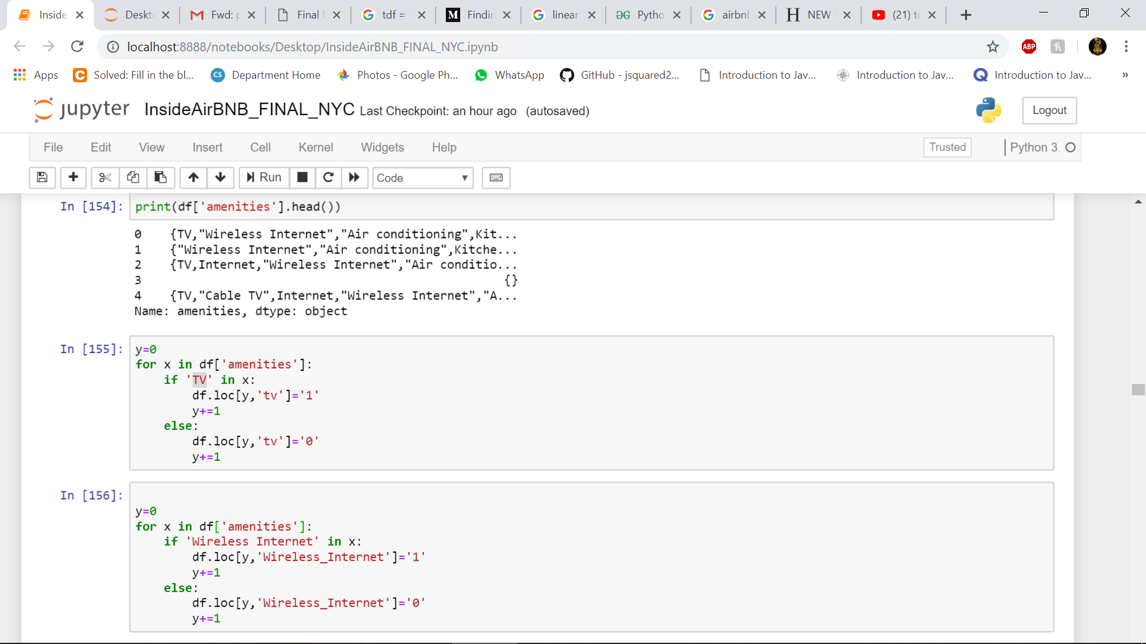
Define A Function To Convert Categorical Feature Into Numerical Feature
We use the following two methods in order to convert strings to floats in pandas Data Frame:
to_numeric method
astype(float) method

Slide 10
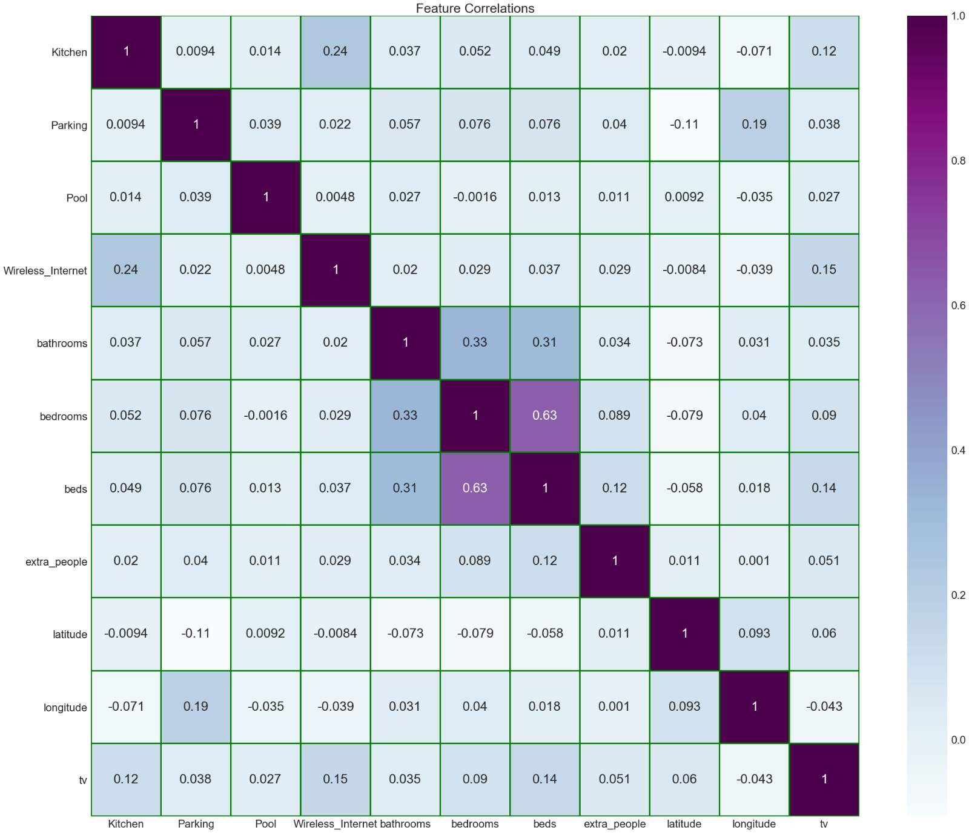
Correlation Between Features

Slide 11
Variable Selection
Feature matrix :
Bathrooms, Bedrooms, Beds, Extra_people, Tv, Parking, Pool, Kitchen, Latitude, Longitude and Wireless_Internet
Label vector :
Price
We randomly split the training dataset into 0.8-0.2 train-test ratio, and then run the following method:
X_train, X_test, y_train, y_test = train_test_split(featured_matrix, label_vector, test_size=0.2, random_state=3)

Slide 12
Models
Model 1: ANN Regression
Model 2: Linear Regression
Model 3: Polynomial Regressor
Model 4: Random Forest

Slide 13
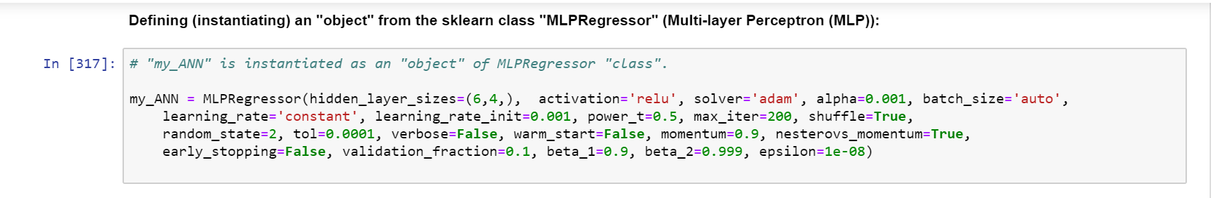
Model 1: RMSE : 69.54 ANN Regression

Slide 14
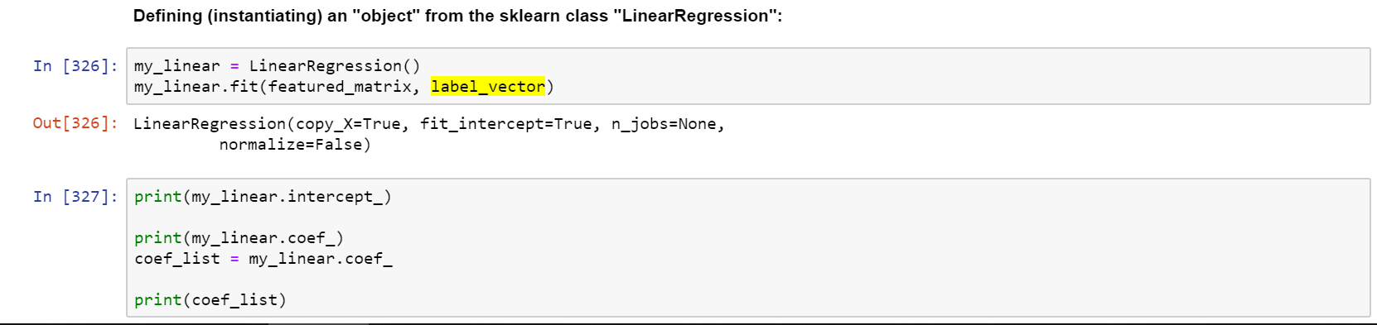
Model 2: Linear Regression RMSE : 68.77

Slide 15
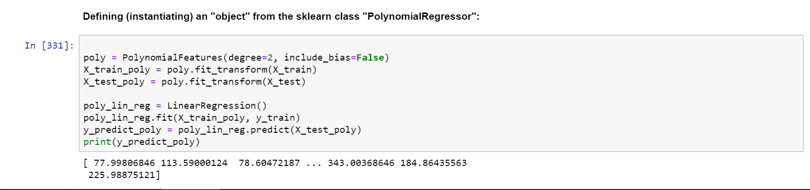
Model 3: Polynomial Regressor RMSE : 62.75

Slide 16
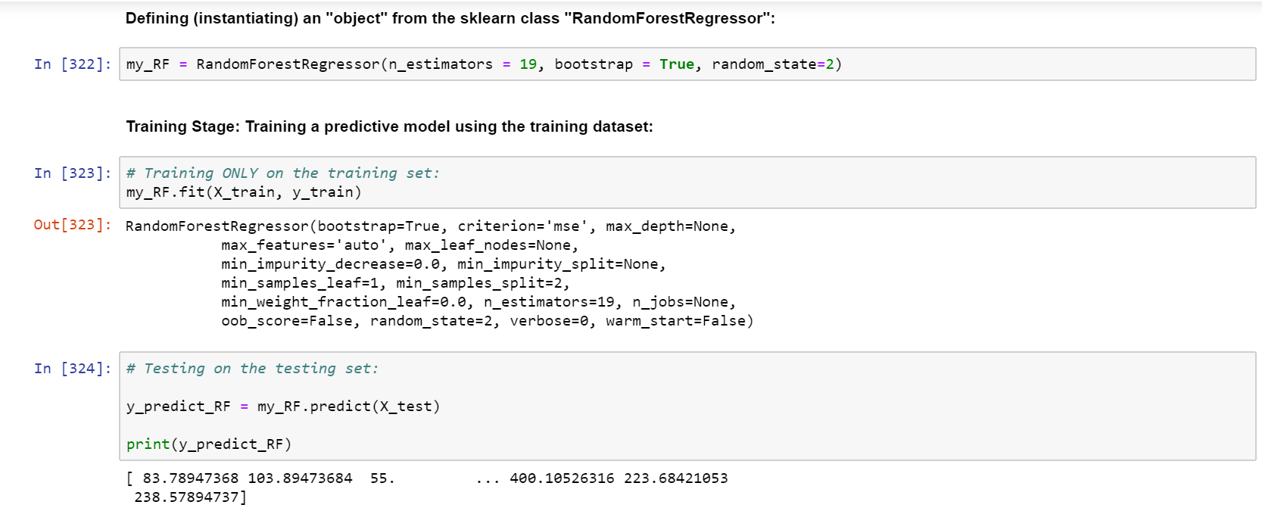
Model 4: Random Forest RMSE : 60.52

Slide 17
Comparison amongst different models
NO | MODEL | RMSE
1 | ANN REGRESSION | 69.54
2 | RANDOM FOREST | 60.52
3 | LINEAR REGRESSION | 68.77
4 | POLYNOMIAL REGRESSOR | 62.75

Slide 18
Conclusion
We compared the RMSE of models, the ANN regression model has the highest one which is 69.54 and the random forest model has the lowest one, which is 60.52.
Random forest model is an effective model to predict the Airbnb price.
The most significant variables for the prediction of price are cleaning fee, bedrooms, accommodates, beds and bathrooms.

